Slide 1
Final project
Group 3
Zhenshu Wu, Wanwan Zhang, Xun Peng

Slide 2
Contents
Part 1: Oracle & MySQL databases building
(DBMS dimensional model & perform queries )
Part 2: Four dimensional data models
Part 3: OLAP (SSAS) cube for each data model with three perspectives
Part 4: Business Analysis using Power BI

Slide 3
Creating MySQL ＆Oracle databases
Create module in Toad Data modeler
Create database in MySQL(Oracle)
Import data from SQL Server to MySQL(Oracle)
SQL query results in databases

Slide 4
Create module
Toad Data Modeler
SQL script to create Database
DataBase
(MySQL ,Oracle)
SQL Server
Export Data
Excel
Import data to Databases
Convert to CSV files

Slide 5
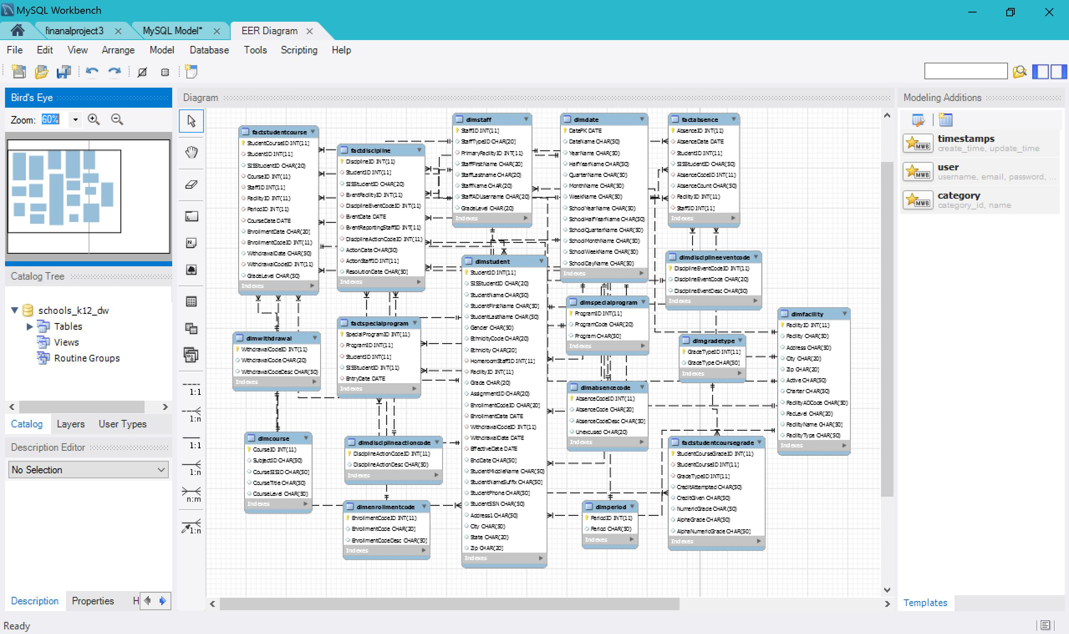
MySQL Database Diagram

Slide 6
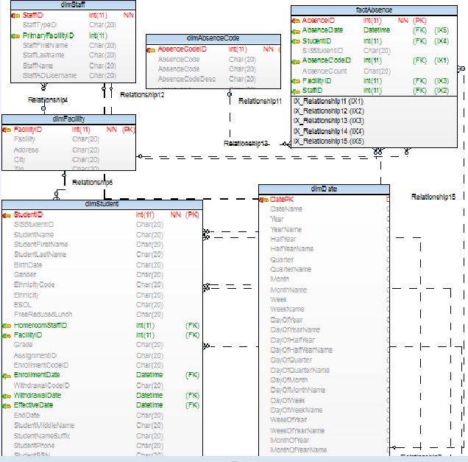
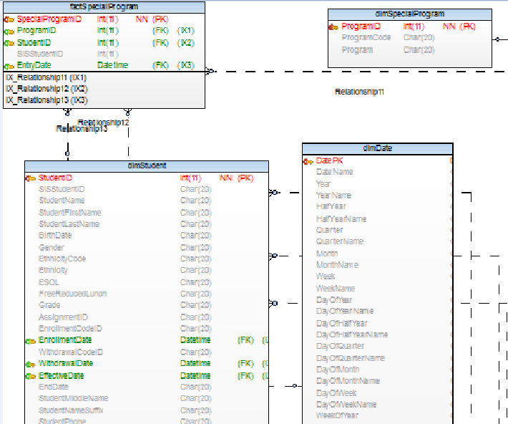
Part 2: Four dimensional data model
Absence
Special Program

Slide 7
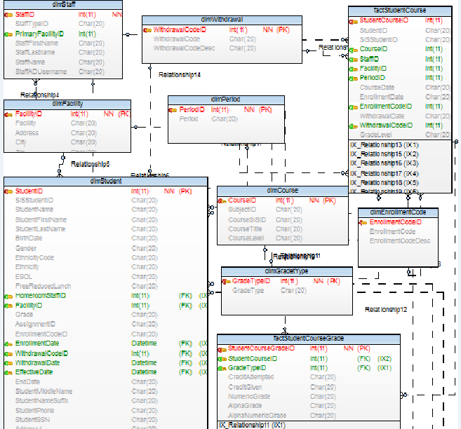
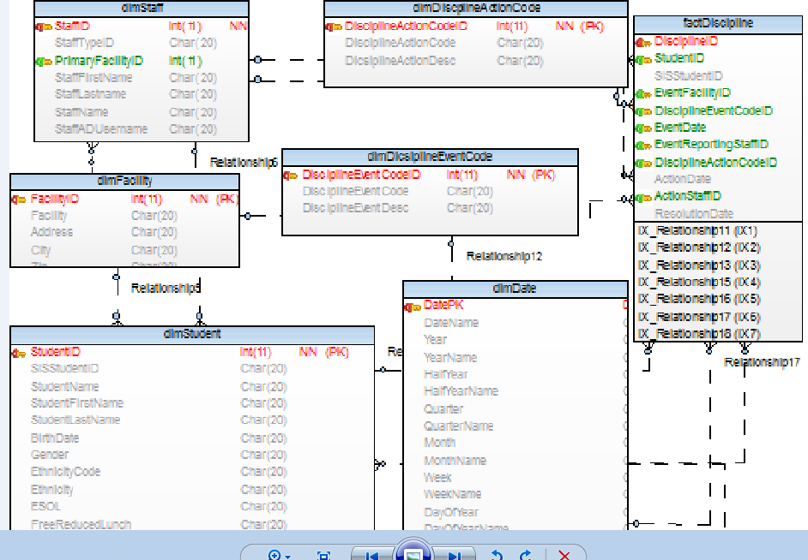
Academic Performance
Discipline

Slide 8
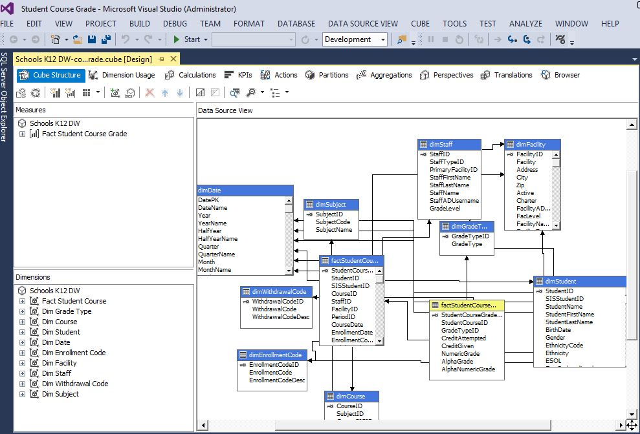
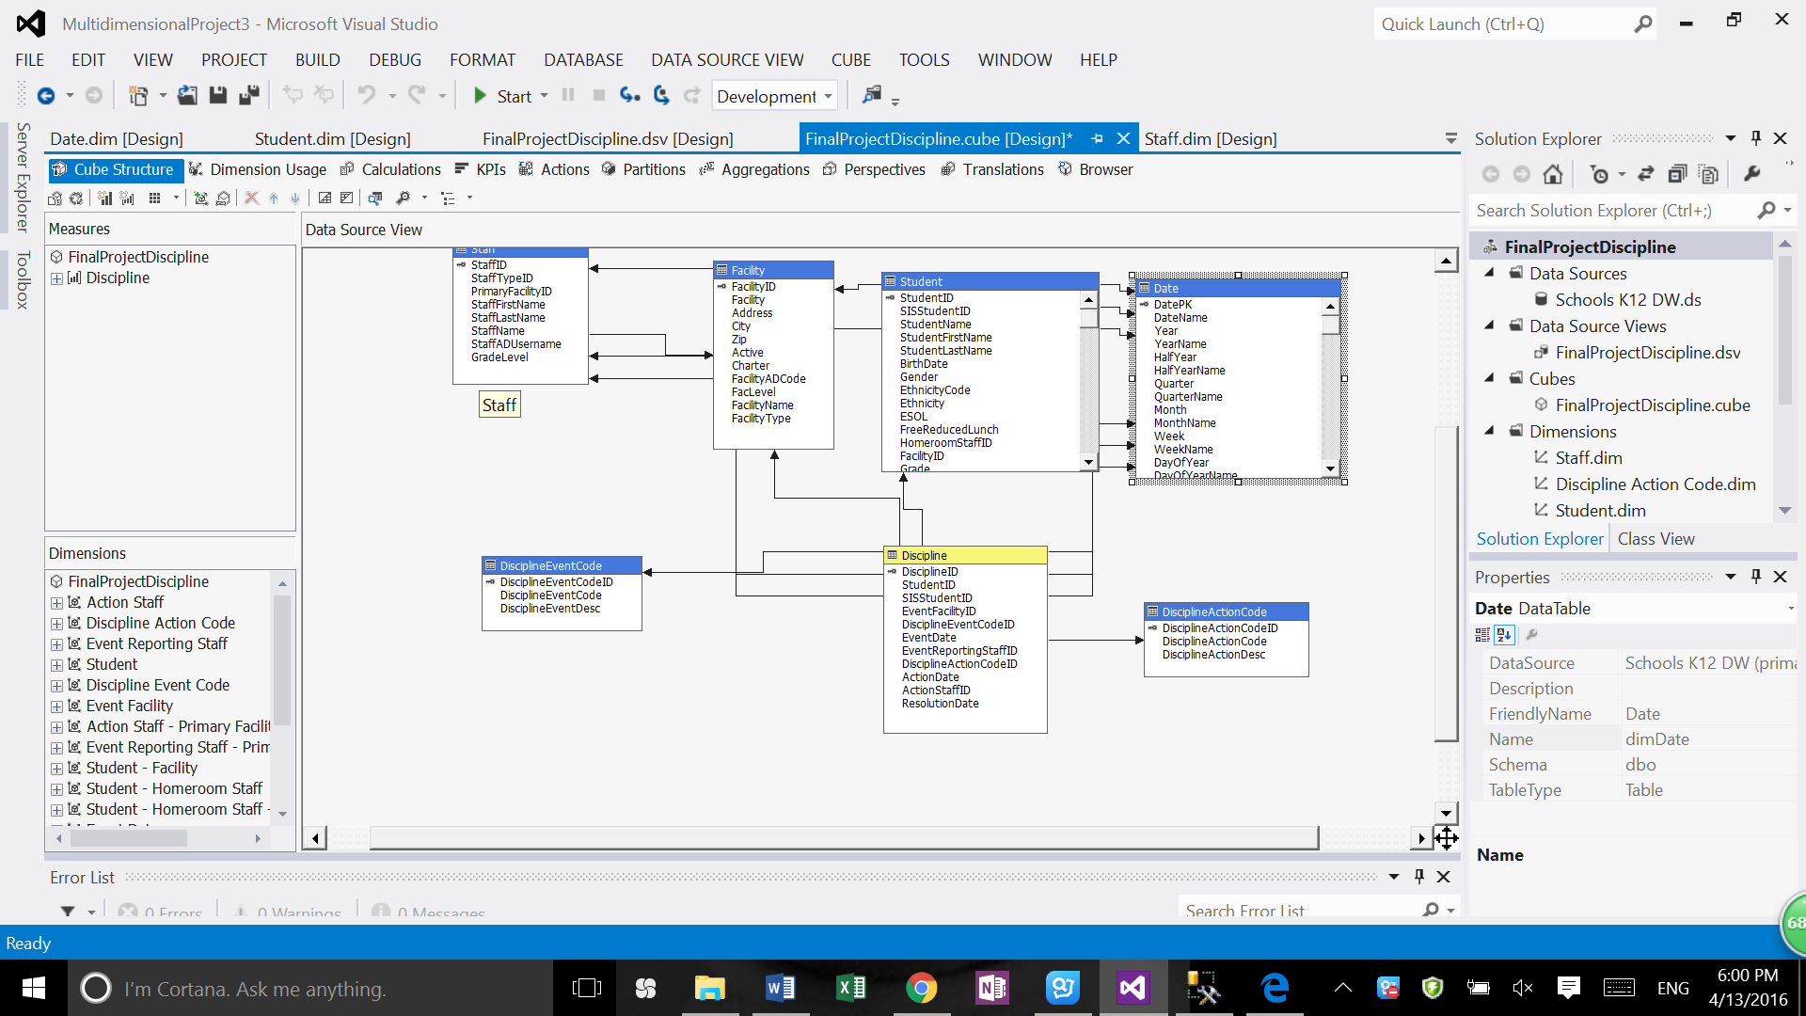
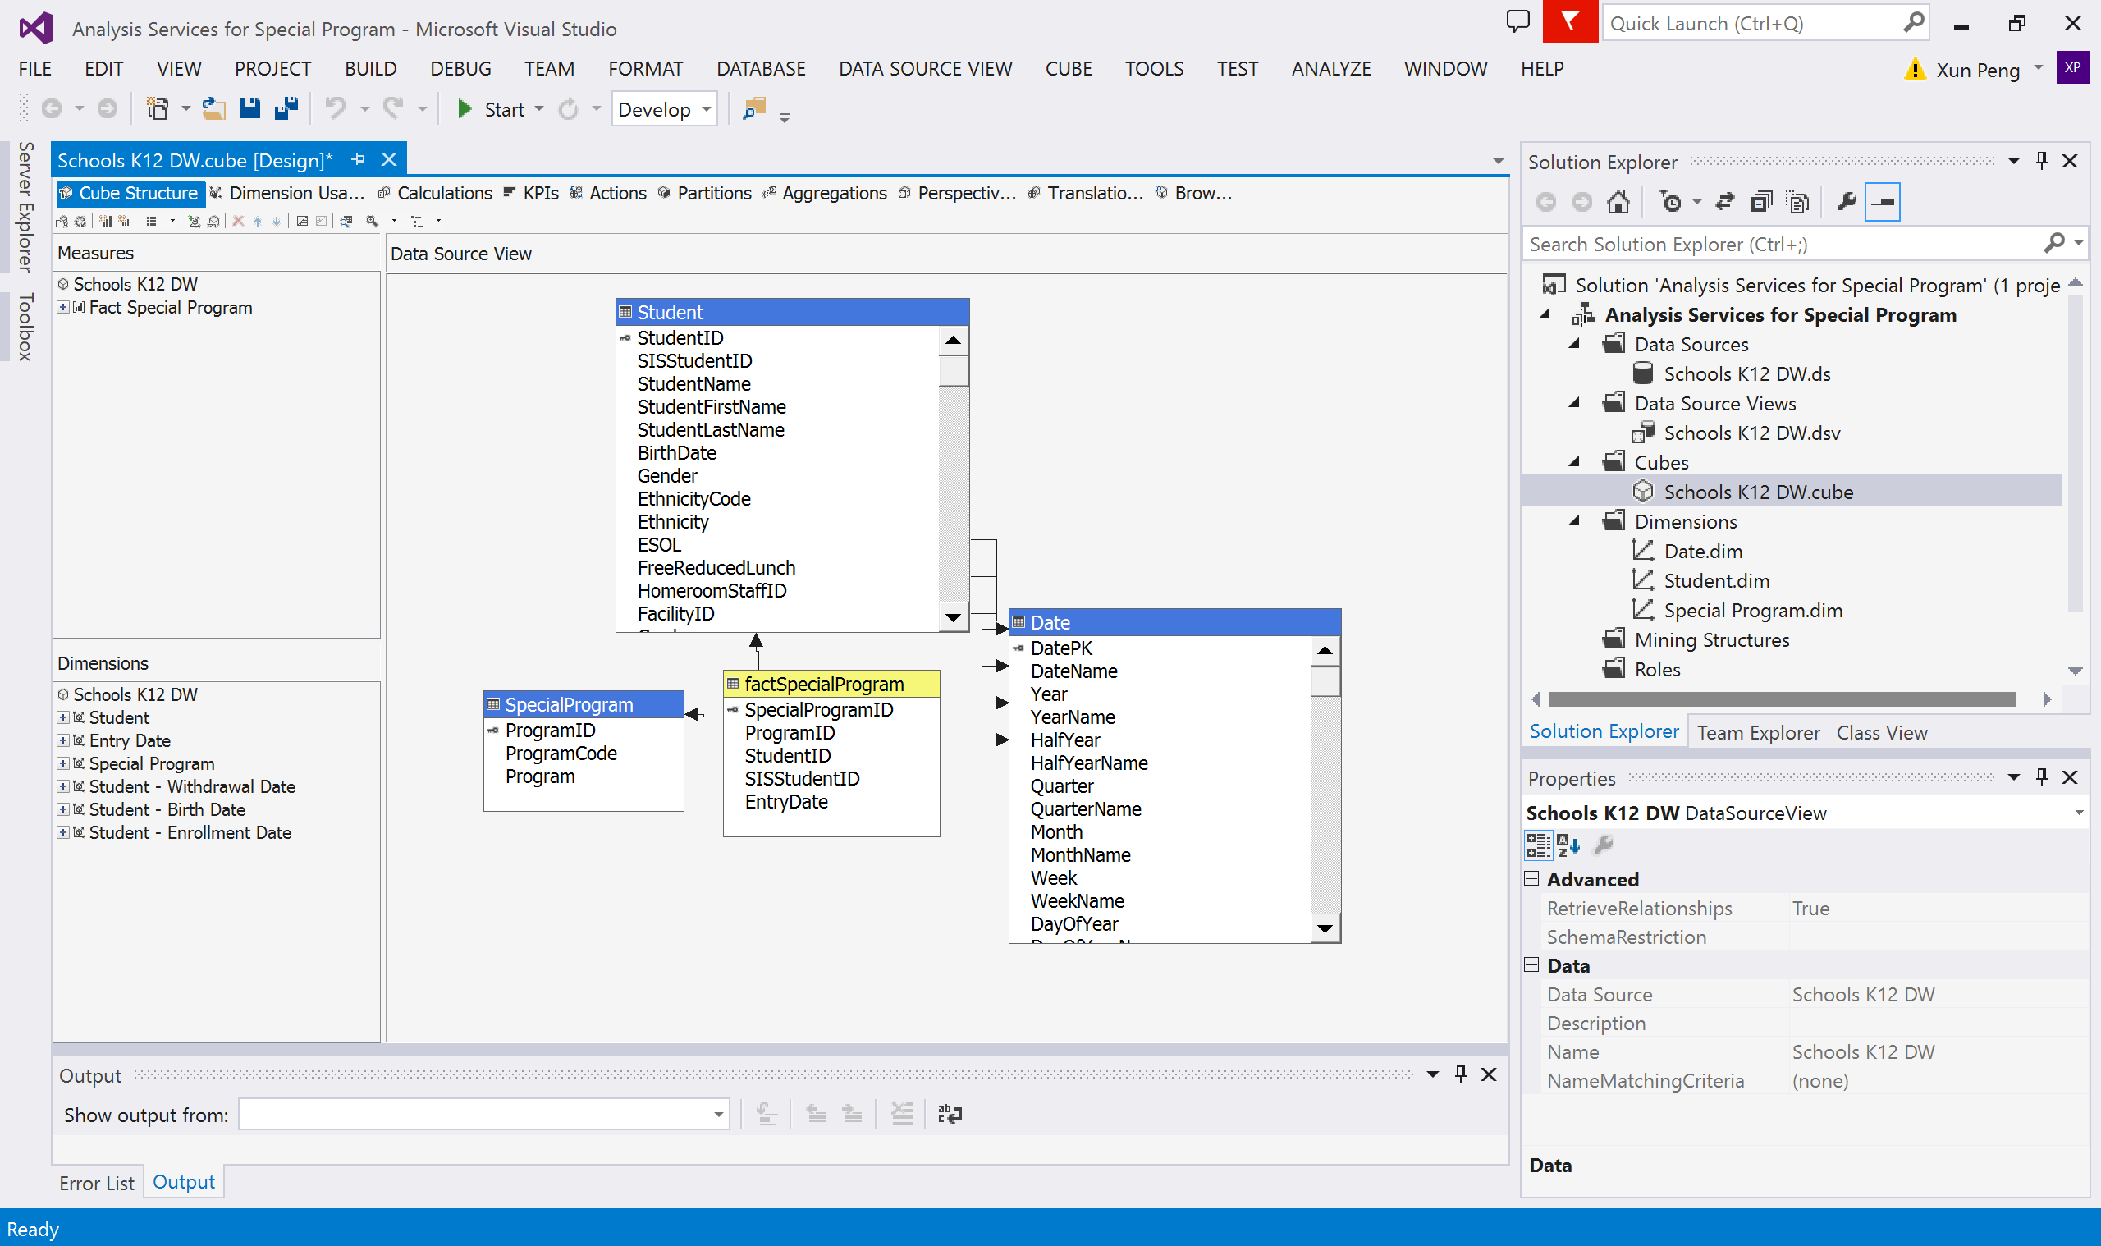
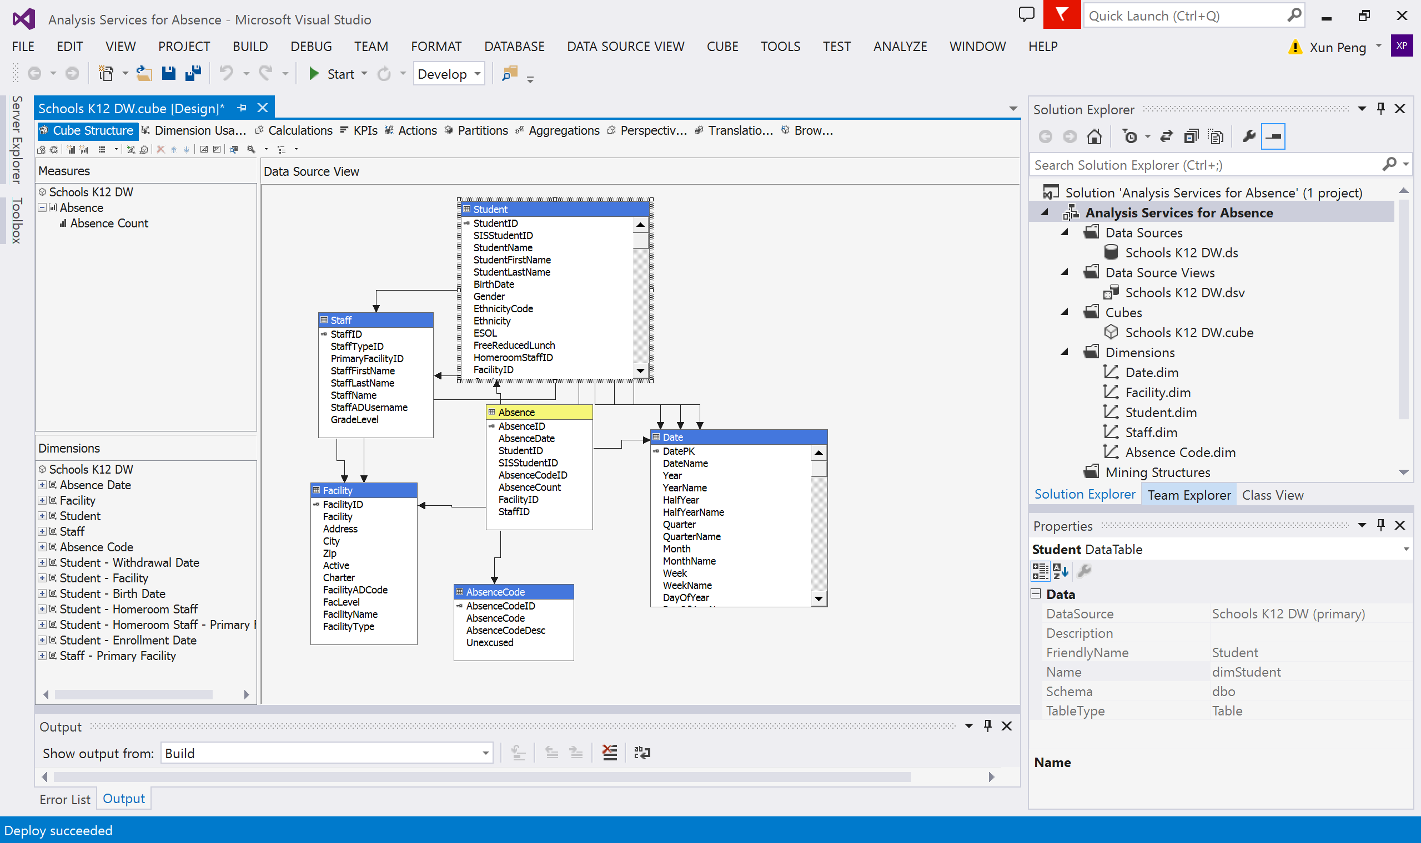
Part 3: OLAP (SSAS) cube for each data model with three perspectives
Course
Discipline
Special Program
Absence

Slide 9
Build hierarchy ex: date: Day---Month---Quarter---Half Year ---Year geography: City---State---Country Role Playing ex: date dimension Share dimension Add measures (Average)

Slide 10
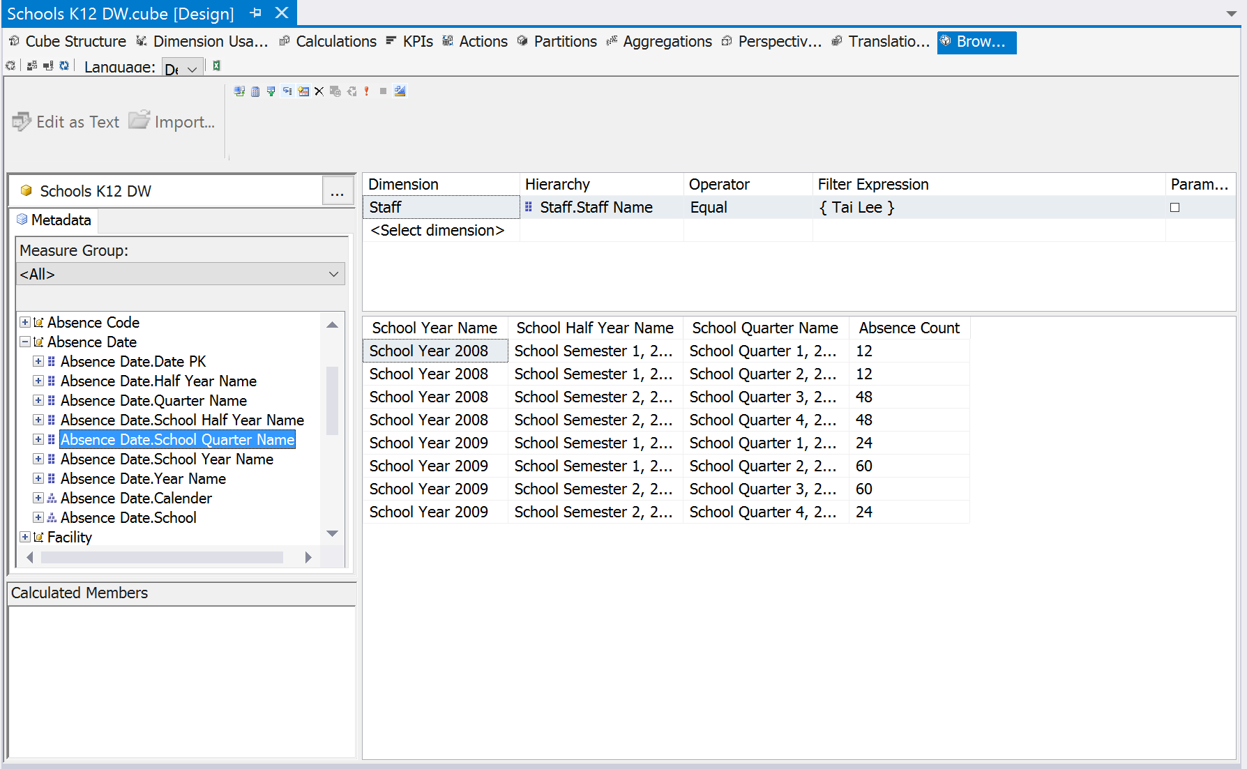
Date Hierarchy

Slide 11
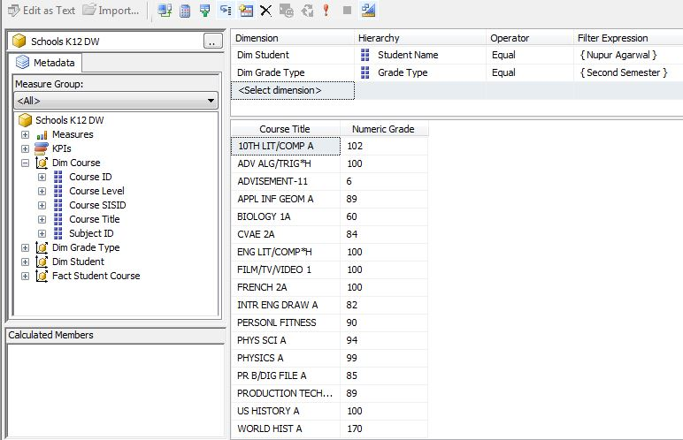
Share dimension

Slide 12
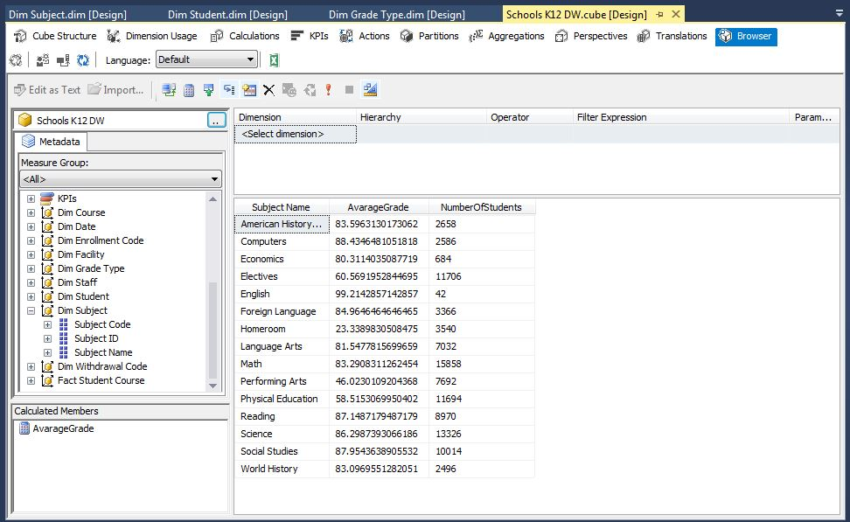
Add new measures and do calculation ex: Average measure

Slide 13
Part 4: Business Analysis using Power BI
Administrator
Parent
Teacher
Importing the data from SQL server analysis services with the cube built in Visual Studio.

Slide 14
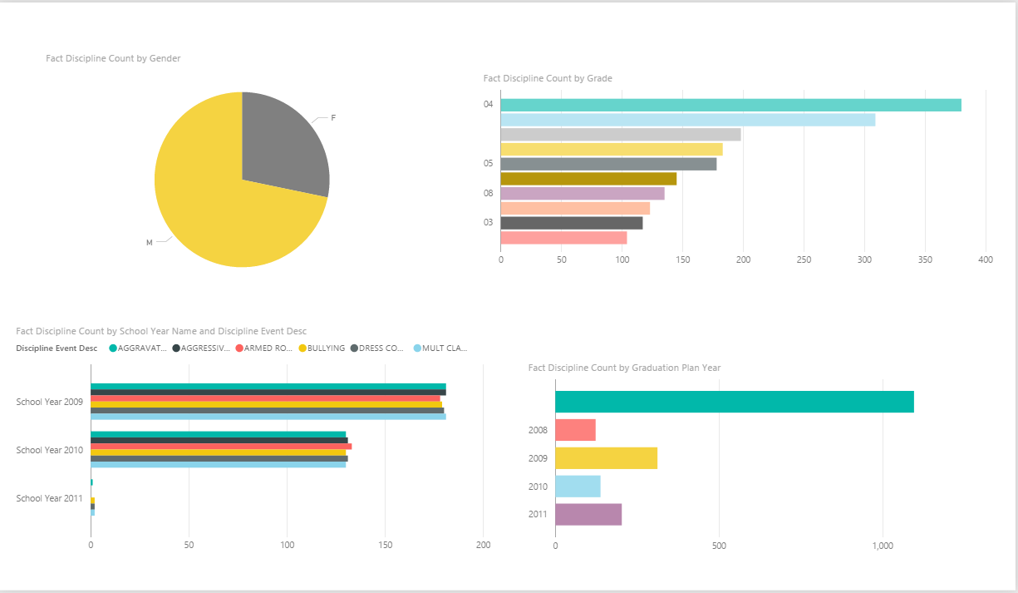
Admin -----the analysis of the discipline event happened by gender, grade, GraduationPlanYear
By Gender
By Grade
By years with different discipline
By GraduationPlanYear

Slide 15
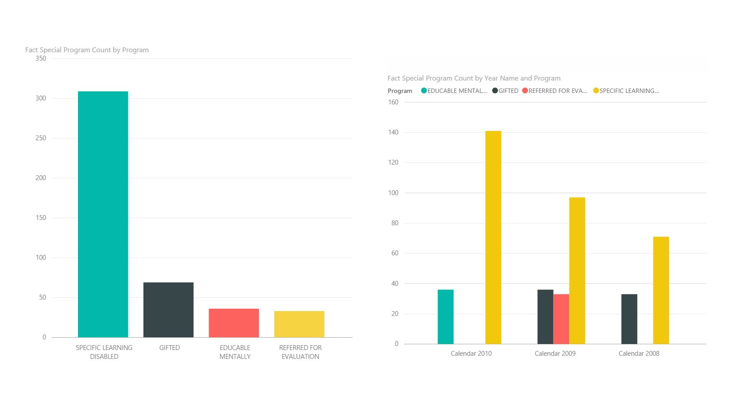
Admin - Special Programs about all students
Special counts by program
Special counts by program

Slide 16
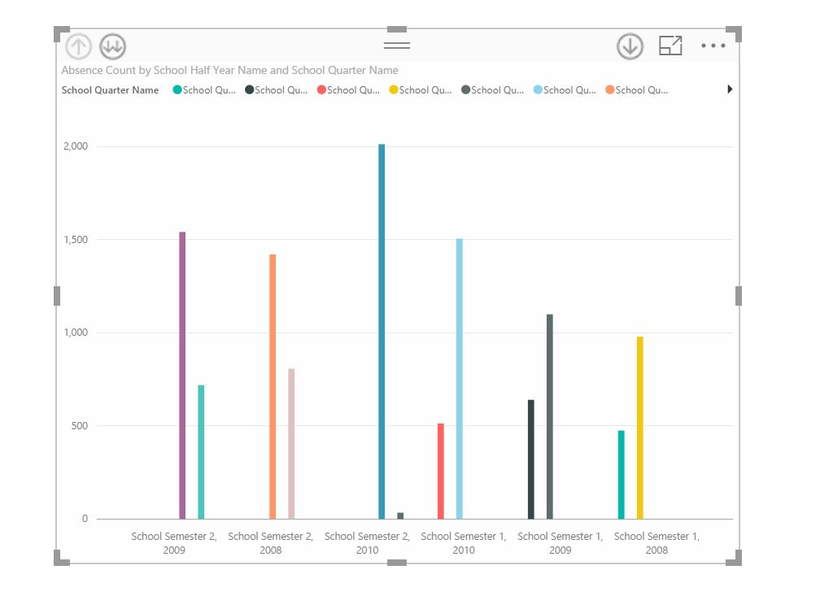
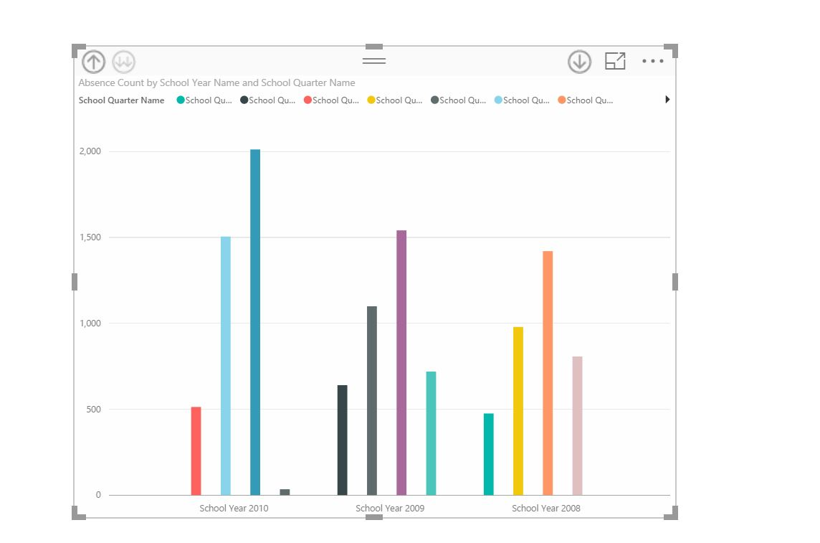
Admin - Absence of all students
Students Absence rate by year by half year

Slide 17
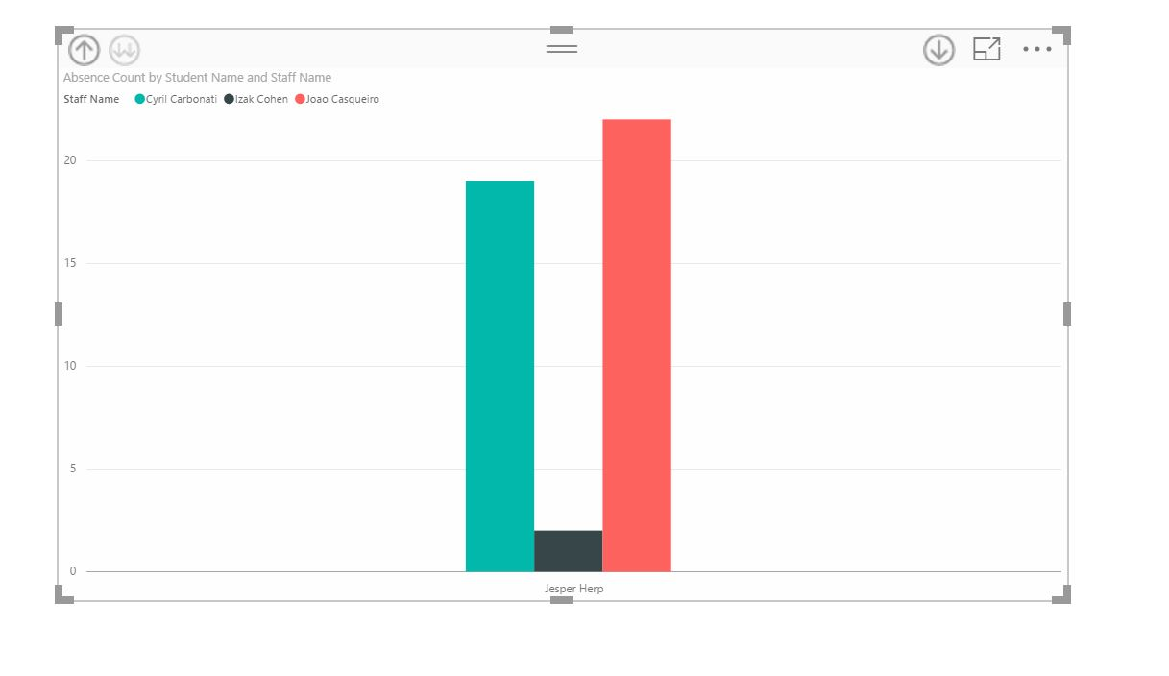
Parent ---specific student absence counts with specific teacher
Absence time of Joao with specific teacher handling

Slide 18
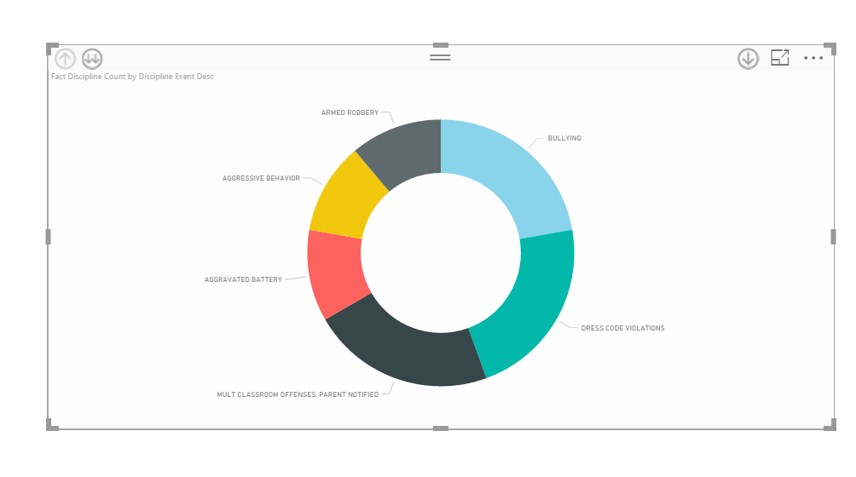
Parent ----discipline
Different types of discipline child did

Slide 19
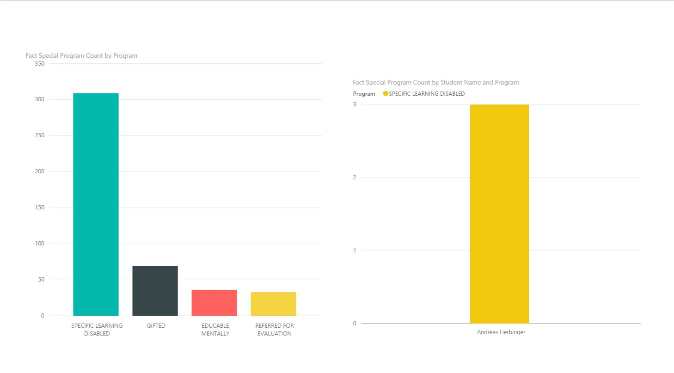
Parent ----specific program
Which special program child choose

Slide 20
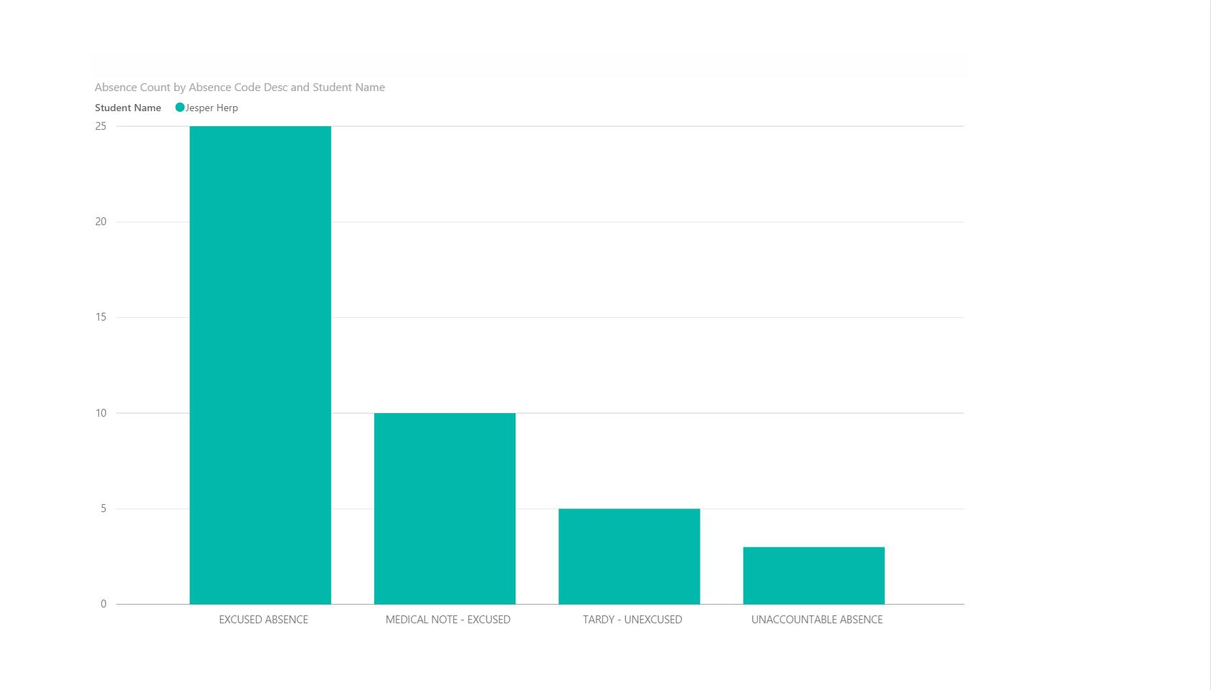
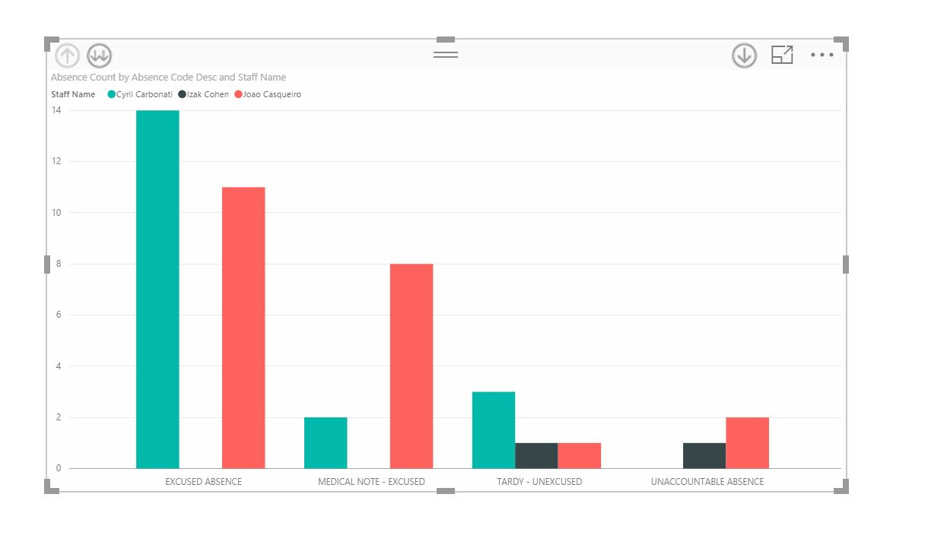
Teacher ------- absence & discipline
Different types discipline by teacher
Different types Absence by teacher handling

Slide 21


